Slide 1
MILk In MINUTES
LAKSHMI.B

Slide 2
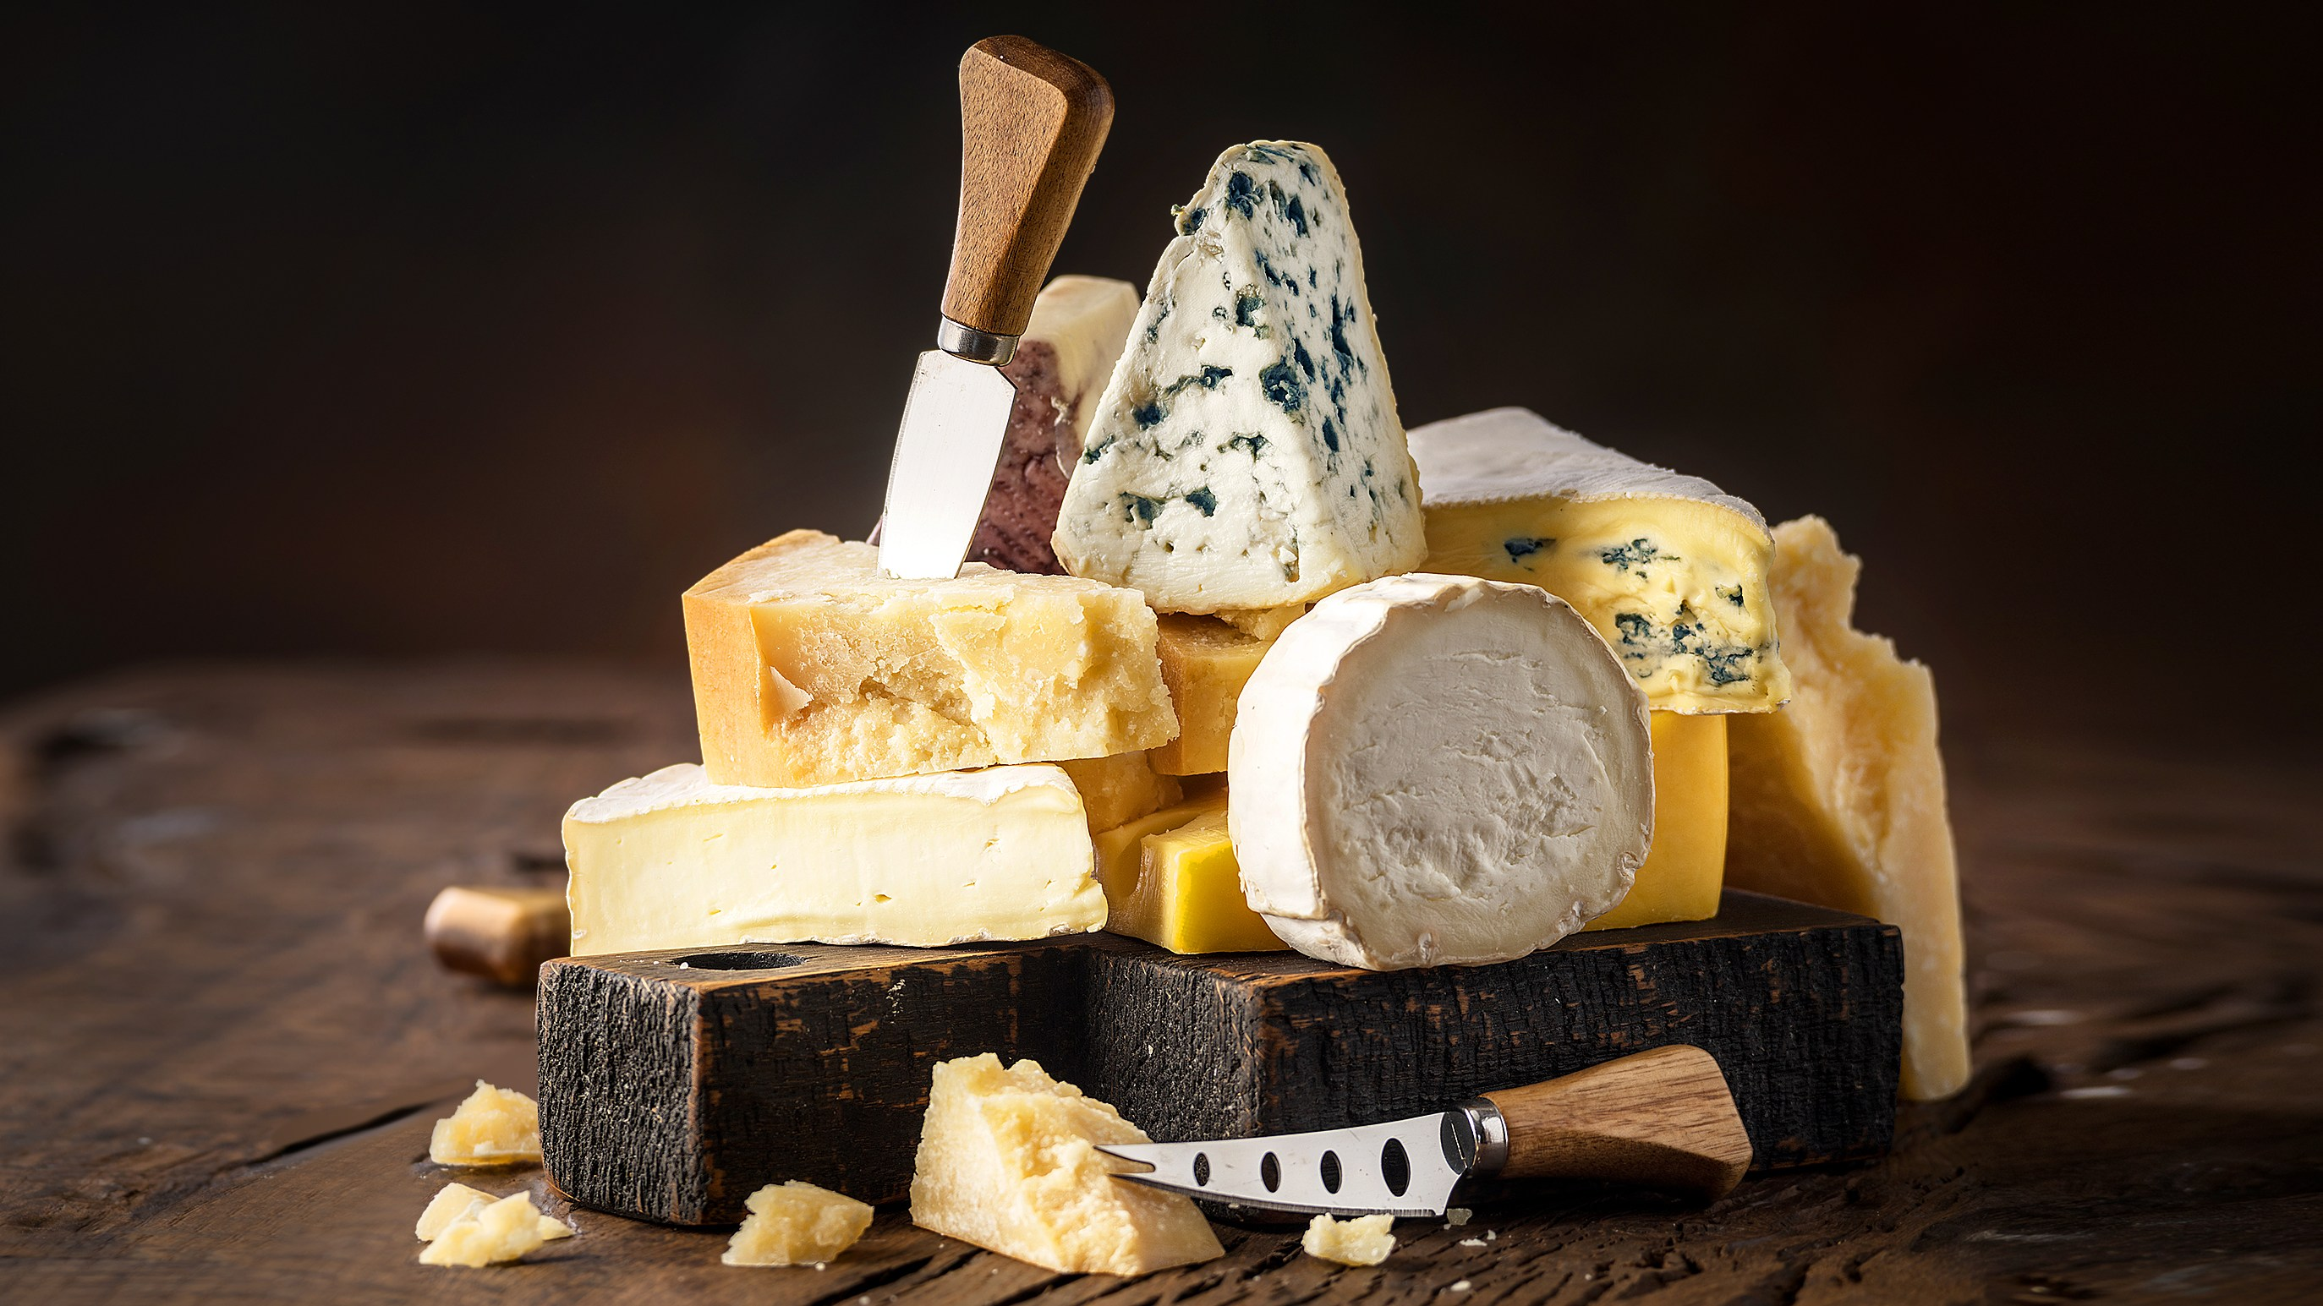
Milk In minute

Slide 3
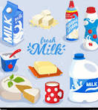
INTRODUCTION
To develop a user-friendly web application for ordering Milk products online, offering a seamless experience for customers and efficient order management for the administrator

Slide 4
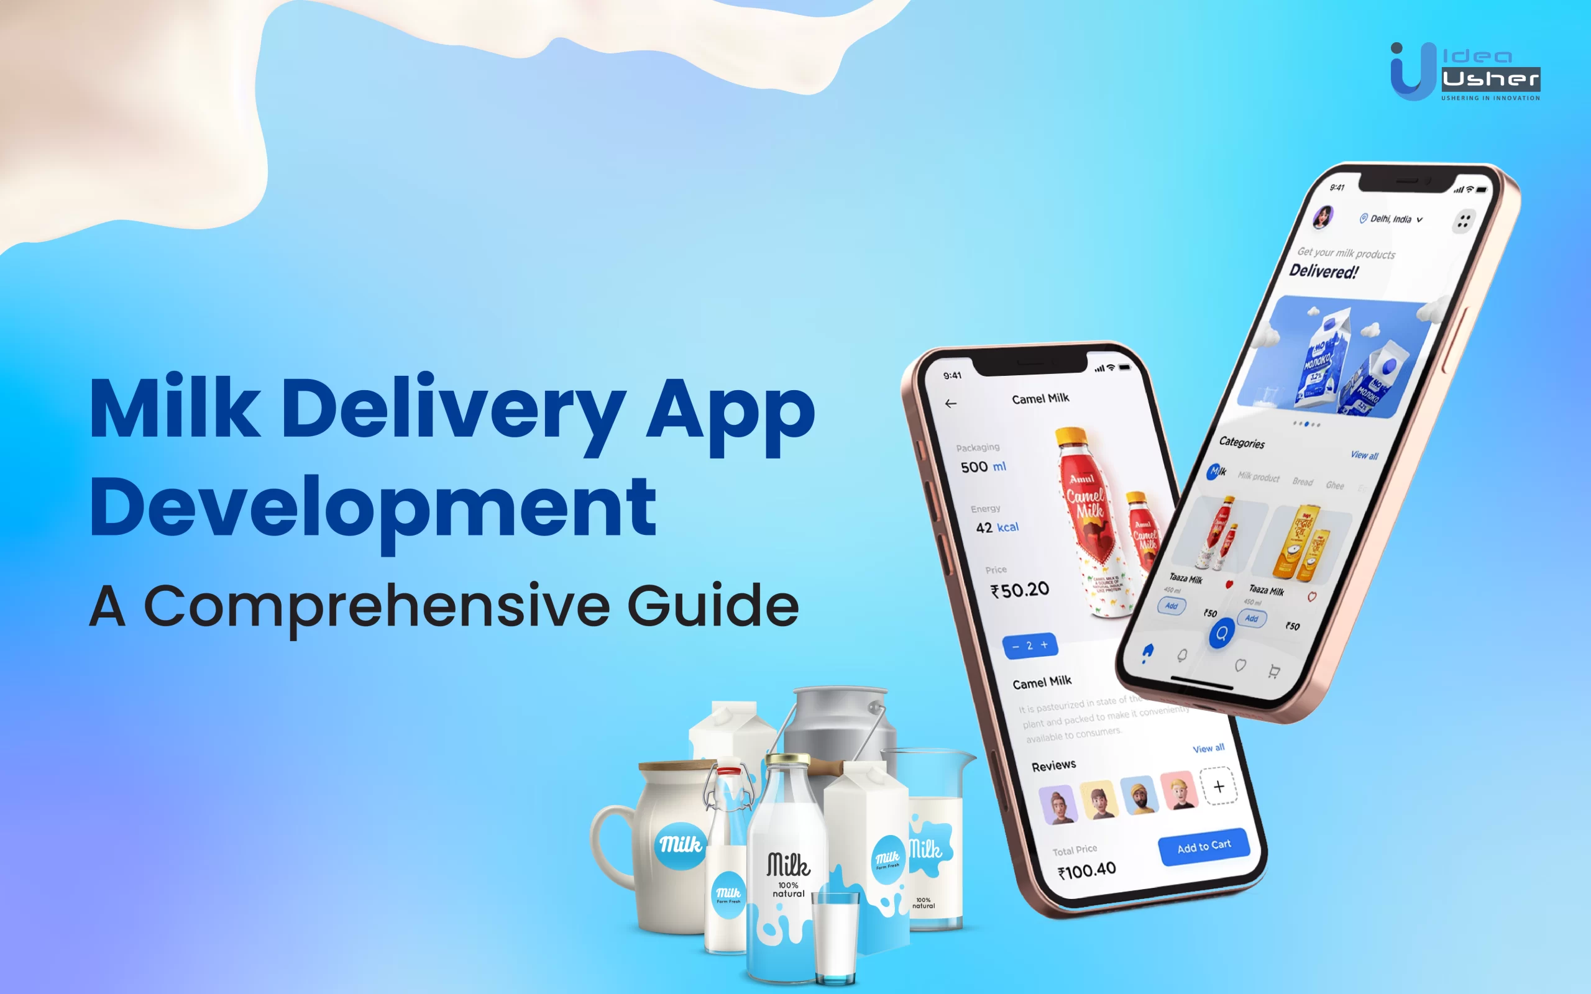
FEATURES
User-Friendly Browsing
User Registration
Login
Product Catalog
Add to Cart
Cart Management
Order Placement

Slide 5





TECHNOLOGIES
Angular: Front-end development framework
JSON: Data format for data exchange
TypeScript: Programming language for building web applications
Authentication: Secure user registration and login using authentication libraries

Slide 6

CHALLENGES
Data Security
User Authentication
Real-Time Updates
Scalability
User Experience
JSON Data Loading

Slide 7

CHAT GPT PROMPTS
1)Create a website using html header section with padding background colour display milk minute
2)The header has padding, a light green background, and is using flexbox to align its contents.
3)The "Milk Minute" text is styled with white color, bold font, and increased font size.
4)The "Home" button has padding, green background color, white text color, rounded corners, and a cursor pointer on hover.
You can add more buttons similarly by duplicating the <button> element and adjusting its text as needed.

Slide 8
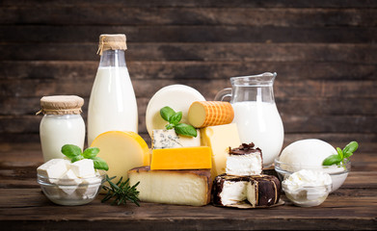
CONCLUSION
Conclude by emphasizing that milk in minute is a user-centric and efficient solution for online milk products ordering, making it easy for users to explore, order, and enjoy delicious milk products

Slide 9


